Slide 1

BREWING: STARBUCKS DATA
Store Density Analysis

Slide 2




TEAM: Smooth Like Data
Members:
Lizette Leano
Ruchi Chandra
Sumana Kar

Slide 3


Questions
How the Starbucks stores distributed globally?
Does store ownership have any demographic relationship?
Does climate have any impact on store distribution?
Starbucks in United States:
Does demographic factors (e.g. population, race, income) has any relation with the Starbucks store count?
How competitive is the coffee shop market in regards to Starbucks?
Sentiments for Starbuck
What is the general sentiment for Starbucks?
What is the sentiment for Starbucks vs its biggest competitors?

Slide 4





DATA SOURCES
files.csv
Tweepy.API
Data Sources
World bank API
Google API
files.csv
Census Gov API

Slide 5
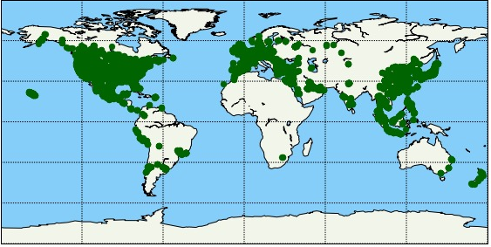
Global Distribution- Analysis
How are the Starbucks stores distributed globally?
Store distribution is more concentrated in North America , Europe and Asia
Presence of store is less in Africa.

Slide 6
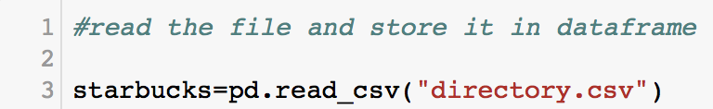
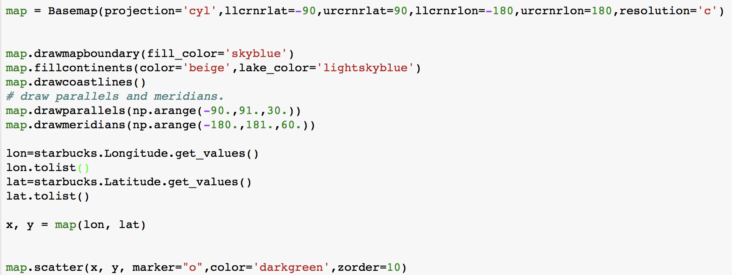
Global Distribution- Approach
Read the csv file and store it in dataframe. Based on this csv file, we have outlined various analysis.
Using Basemap package, plotted the global distribution on store based on the latitude and longitude of the store location.
Challenges:
Location point of the store only showing in the coastal area.
Resolved with Zorder (this is for layering index)

Slide 7
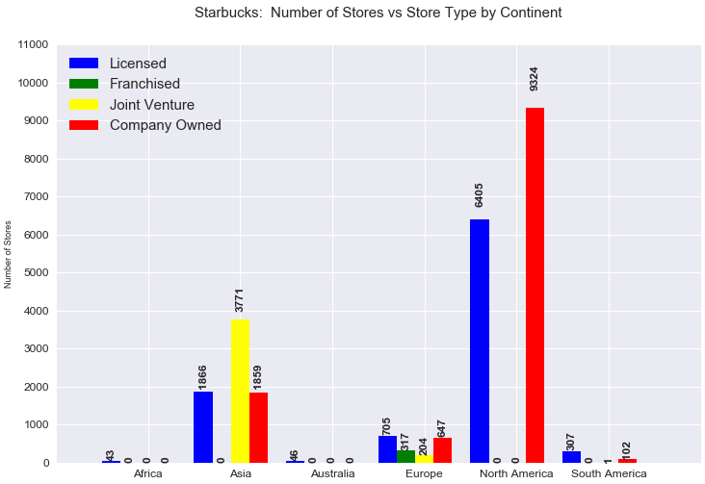
Global Store Ownership - Analysis
Does store ownership have any demographic relationship?
North America has store which are mostly owned or licensed
Most of the store in Asia a joint ventured
Store count in South America, Africa and Australia is very less compared to other continent

Slide 8
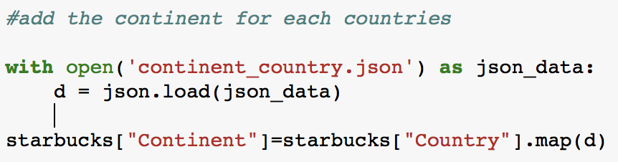
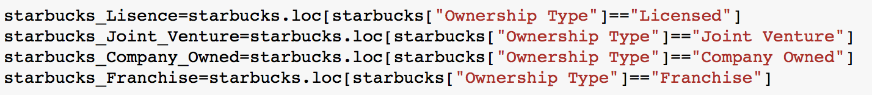
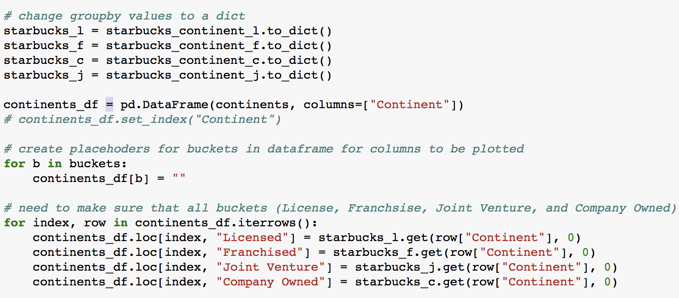
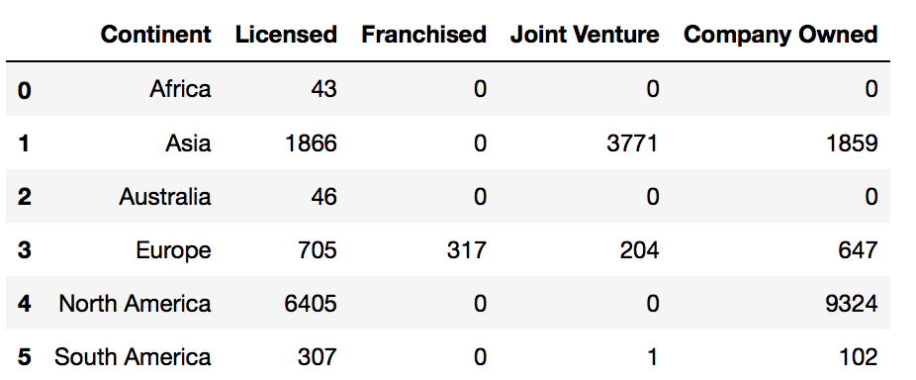
Global Store Ownership - Approach
Based on the County and continent Json file, mapped each of the country of the store to respective continents.
Created multiple buckets based on the store ownership.
Challenges
Based on our data, there were continent which didn’t have any value for each type of store ownership. Plotting using different x-axis was a challenge.
Using get method, made sure each continent bucket have all the ownership type. Whenever there is missing ownership, passed a default value of ‘0’.
This is our final dataframe, based on which, using matplotlib, graph is plotted for each ownership vs continent.

Slide 9
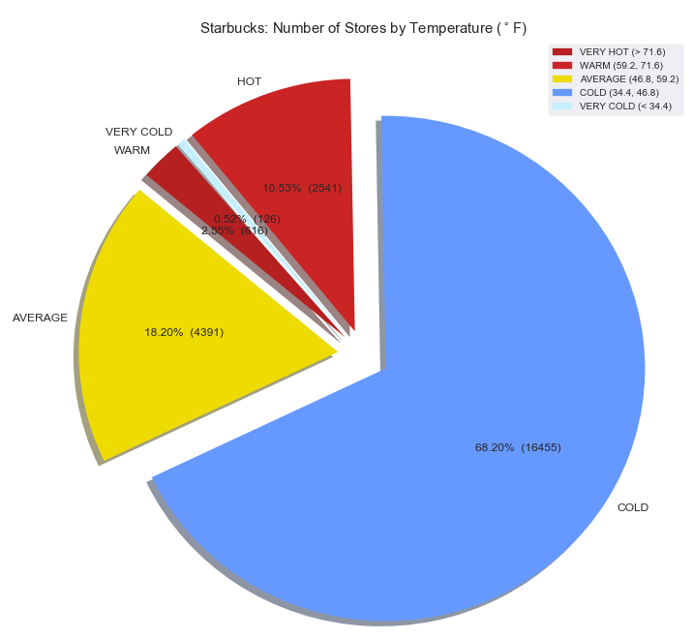
Climatic Impact- Analysis
Does climate have any impact on store distribution?
Based on the analysis, 68% of the store are in cold countries
All the extreme climatic condition (Hot/very cold) has less than 10% of the store.

Slide 10
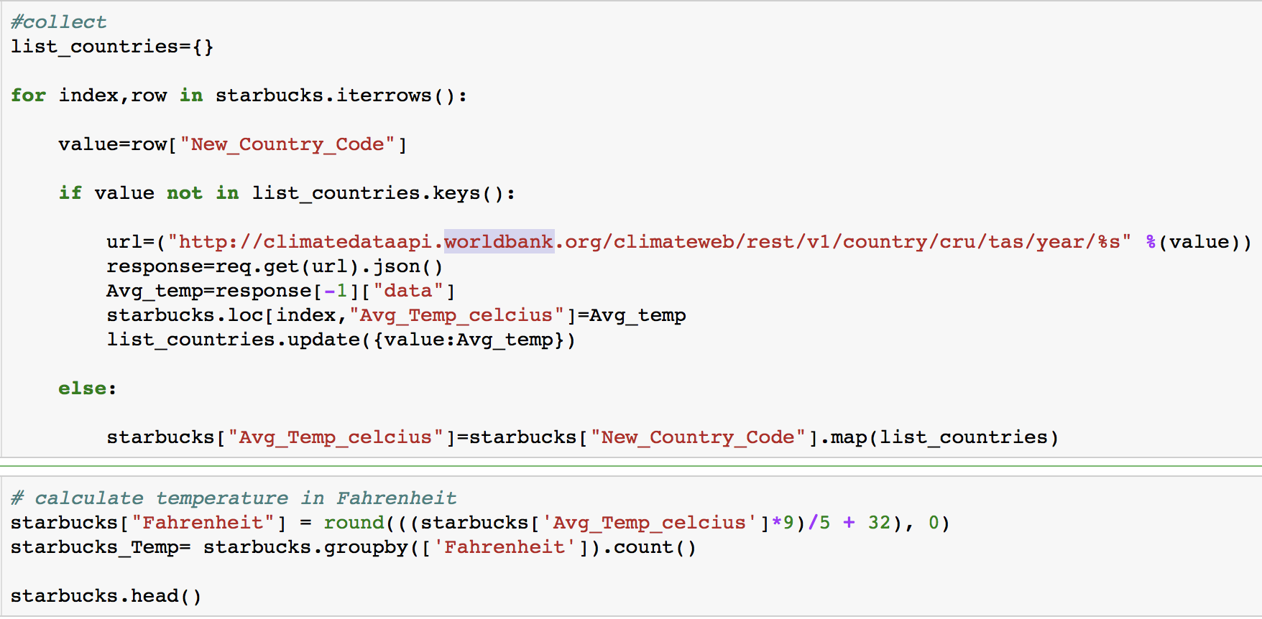
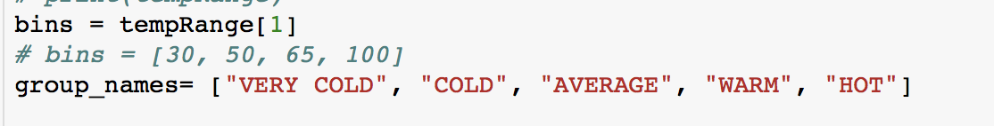
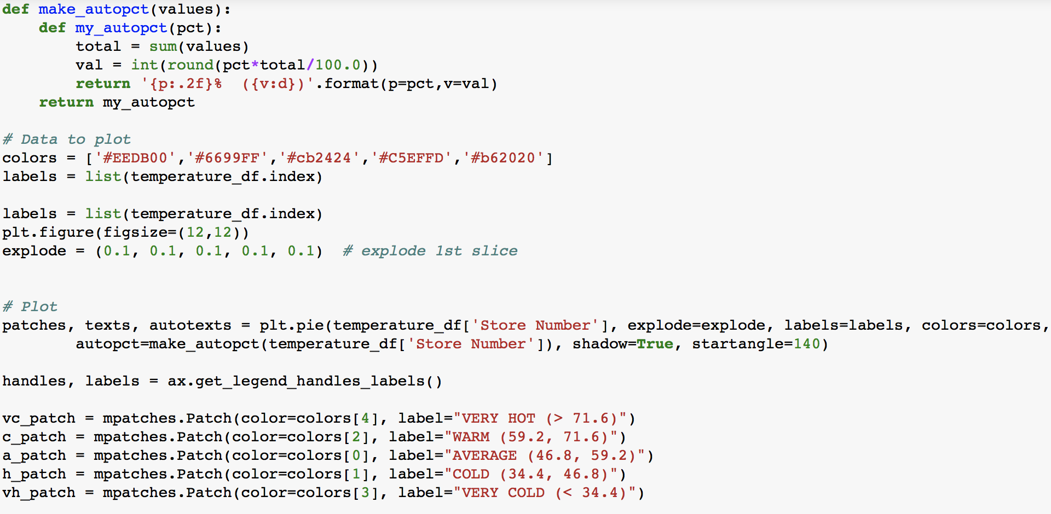
Climatic Impact- Approach
Used world bank data API call to get all the average temperature based on the country code.
Challenge:
World bank API need country code in alpha3. Used pycountry to convert the country code from alpha2 to alpha3. Created CSV file from the result to optimized the code.
Created the temperature bin to provide analysis.
Plotted the pie chart with Matplotlib

Slide 11
Store Distribution Across USA
What is the store distribution?
How competitive is the café market?

Slide 12
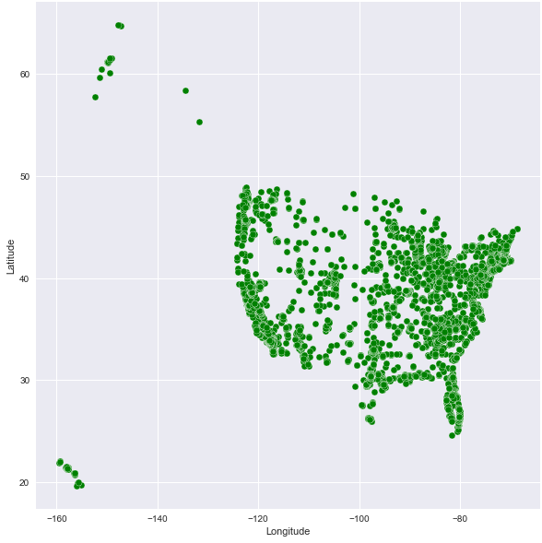
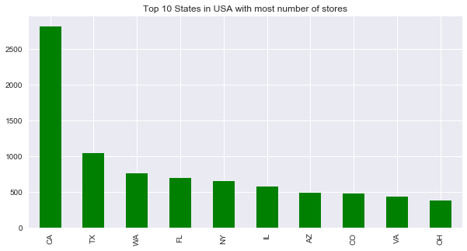
Stores across USA - Analysis
How are the Starbucks stores distributed in USA?
Starbucks Stores across United States:
Total number of Starbucks stores – 13,608
California alone has 2821 stores
The spread of stores across the eastern coast is more than most part of USA
Top 10 states with most store of Starbucks:

Slide 13
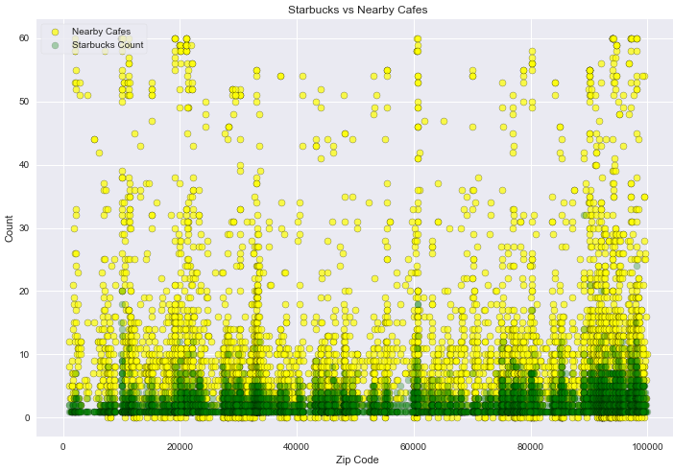
Competition with Nearby Cafes - Analysis
How competitive is the coffee shop market in regards to Starbucks?
Number of Starbucks and nearby cafes per Zip code:

Slide 14
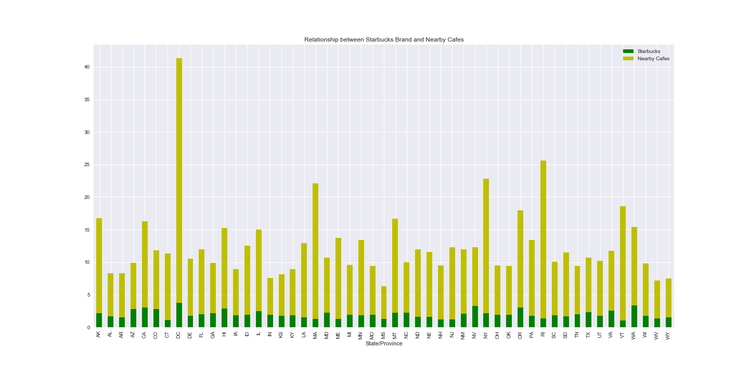
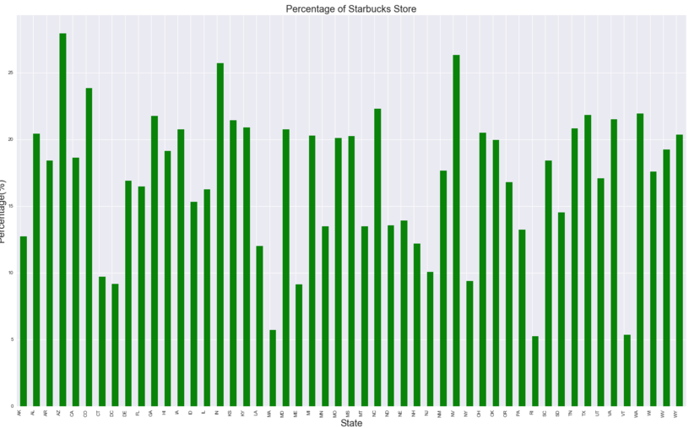
Café Competition by State- Analysis
Average number of Starbucks and nearby cafes per state:
On an average, Starbucks has less number of stores as compared to the other nearby cafes.
% of Starbucks stores in each state:
DC has the max average store count(~40) , only 9 % of these stores are Starbucks
Arizona has average store count of ~10, 28% of these stores are Starbucks

Slide 15
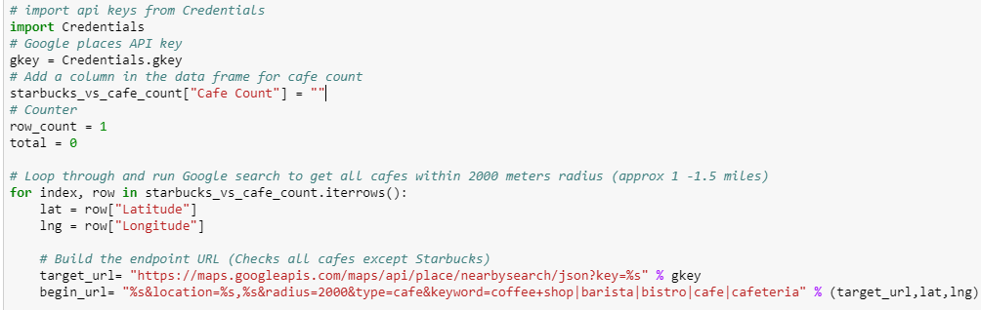
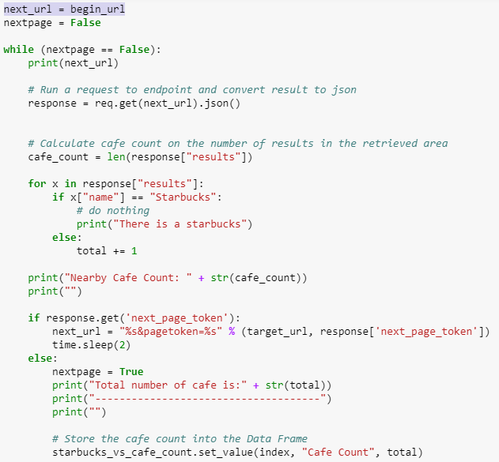
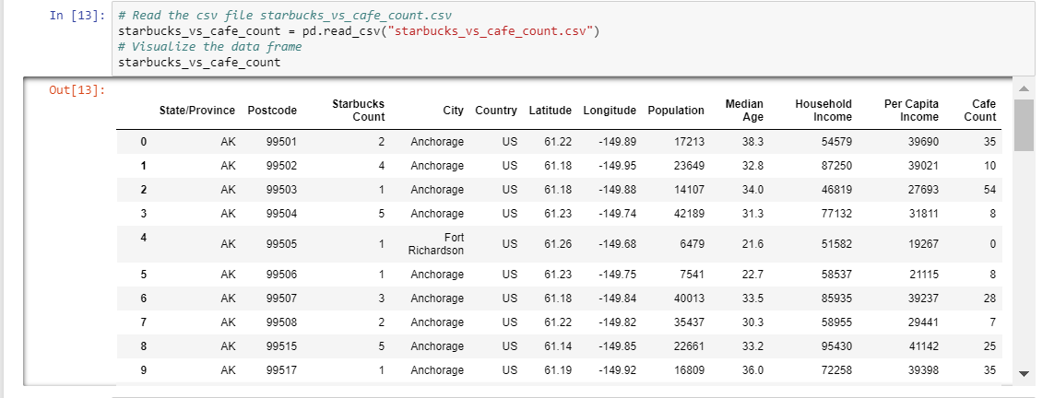
Competition with Nearby Cafes - Approach
Steps:
Created and enabled google API key
Loop through and run Google places search to get all cafes within 2000 meters radius (approx. 1 -1.5 miles) for over 6000 observations
Challenges:
Running through all the rows as google places search allows only 1000 requests per day
Pagination issue, google places search gives only 20 results in a call
Response was including Starbucks as a result for that particular location
Steps:
Created dataframe with Starbucks count and other café count
Calculated the average number/percentage of Starbucks and nearby cafes per state
Plotted using Matplotlib.pyplot and Seaborne python packages

Slide 16
Demographic Factors on store distribution across USA
Does population per state or race have any relationship with store count ?
Does Starbucks target a specific age group?
Does income have any relationship with store distributions?
Are there enough Starbucks in nearby neighborhoods?

Slide 17
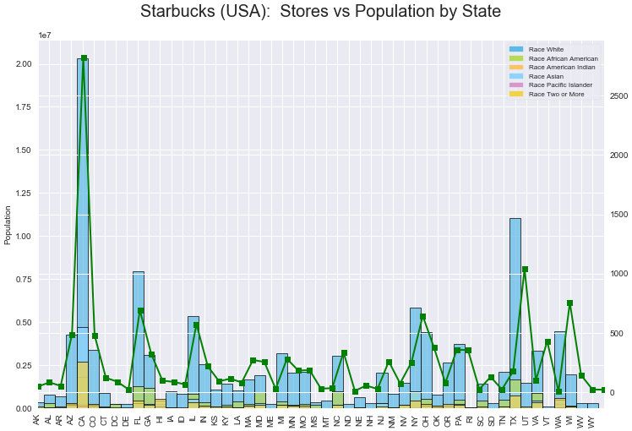
Population Impact - Analysis
Does population or race per state have any relationship with store count ?
California has the maximum number of stores (2821) and the highest population (32,812,499 ) which shows that there is a relationship between store and population
Washington and Utah shows no relationship with store count and population. Also there are many states with less population but more stores
files.csv

Slide 18
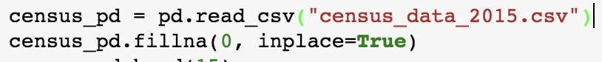
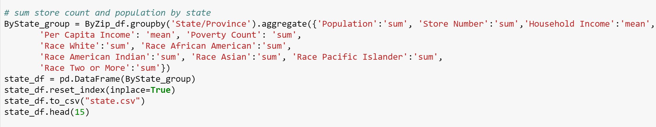
Population Impact - Approach
After creating the USA dataset from the main dataframe, used Census API. For the code optimization, created a csv file . The merged dataframe has all the census data with respect to each Zip code
Grouped the data by State and compared the population against the Starbucks stores

Slide 19
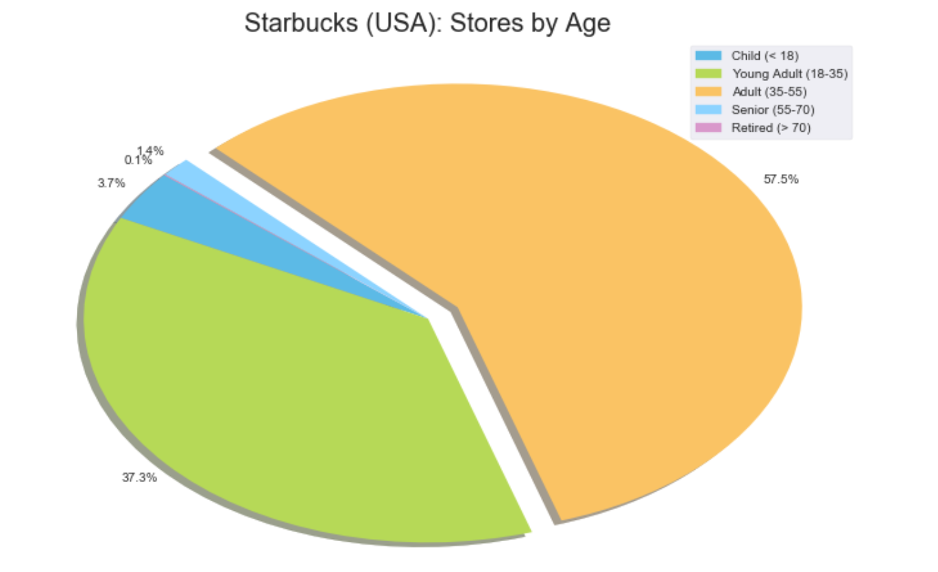
Target Audience- Analysis
Does Starbucks target a specific age group?
As per the analysis, the most number of stores target individuals aged 35-55 (~58%).
The least number of stores are found in areas where the age group is above 55

Slide 20
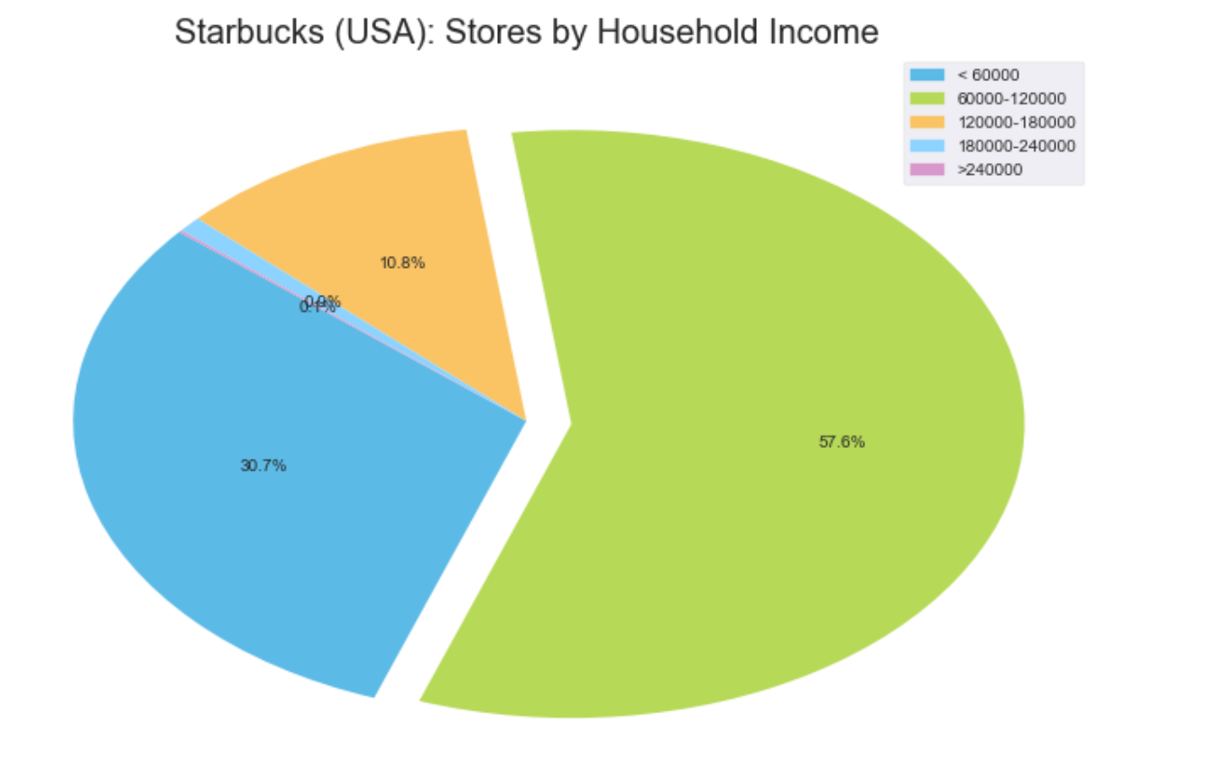
Income- Analysis
Does income have any relationship with store distributions?
As per the analysis, Starbuck’s target customer are those individuals whose household income level are between $60,000 and $120,000

Slide 21
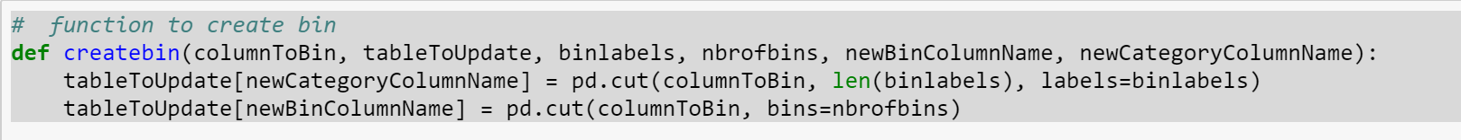
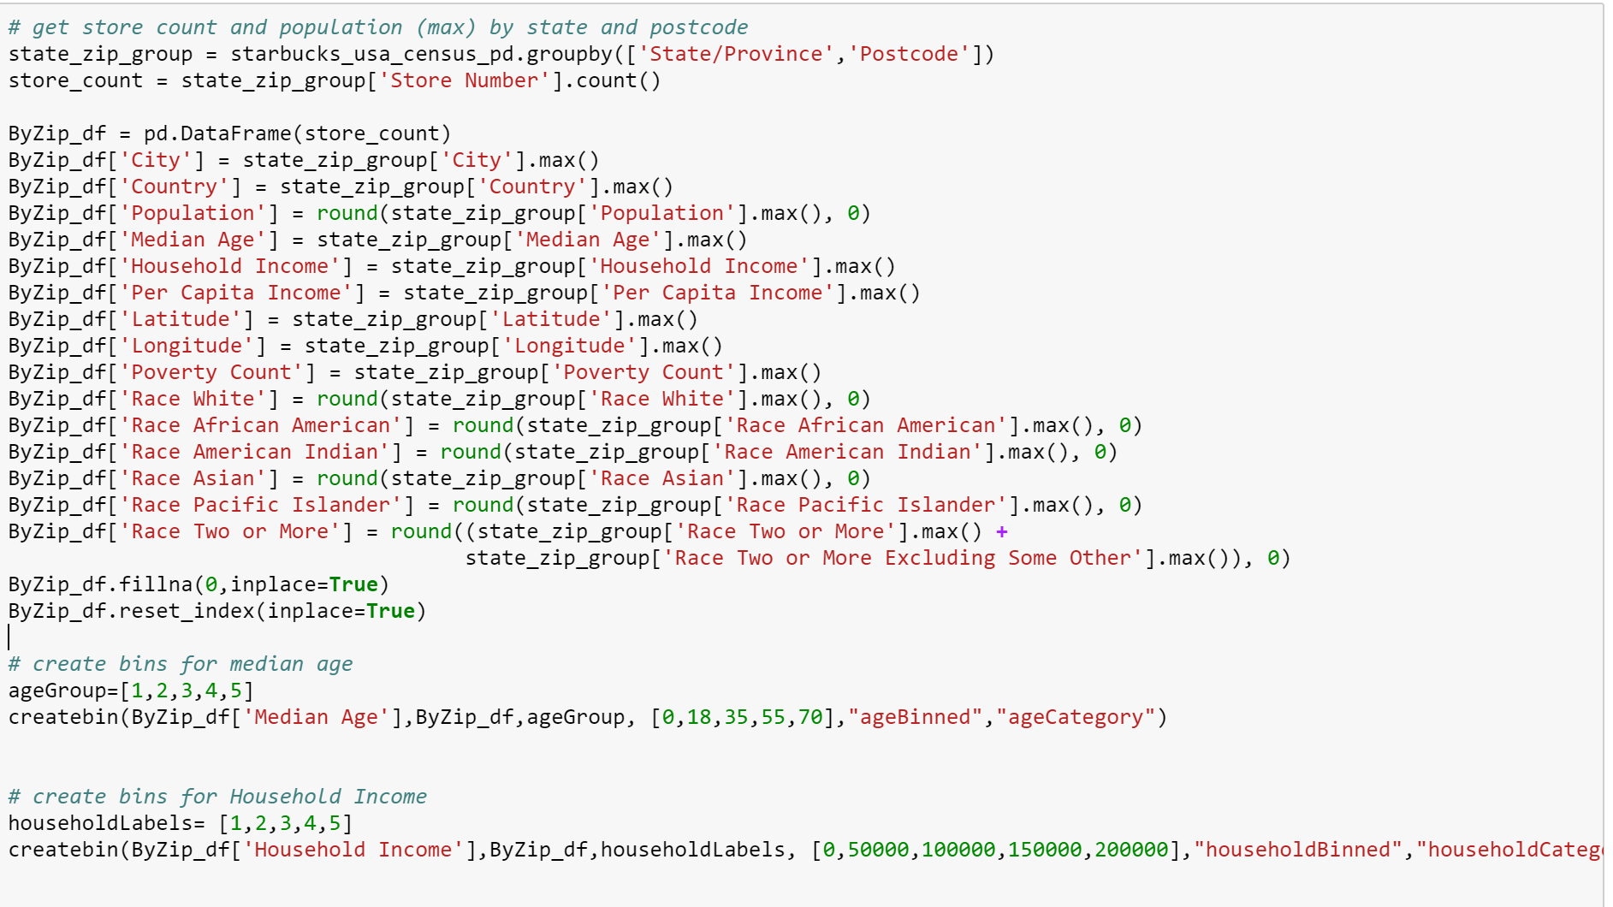
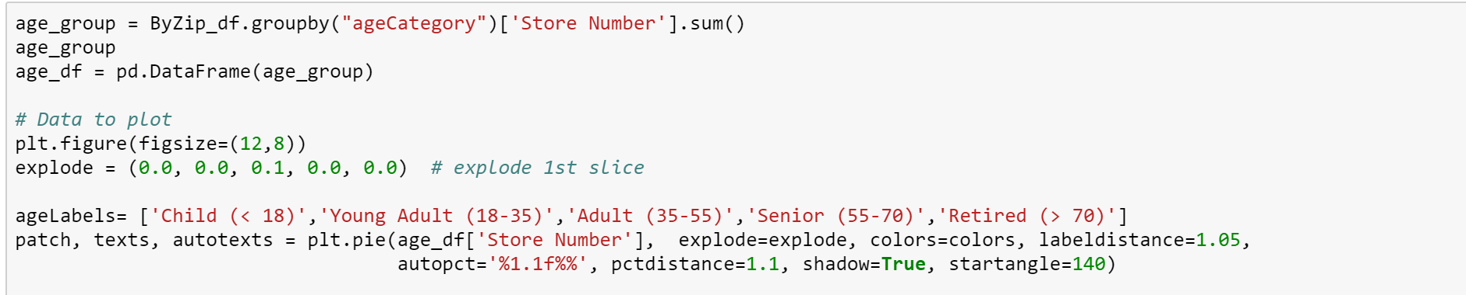
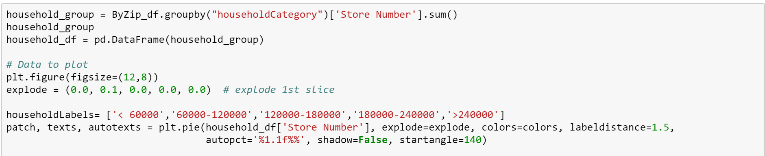
Approach
Created a function to create bins for different analysis throughout the code
Called the “createbin” function to create bins for 5 age and Income groups.
Counted the stores by Age and Income group in respective code

Slide 22
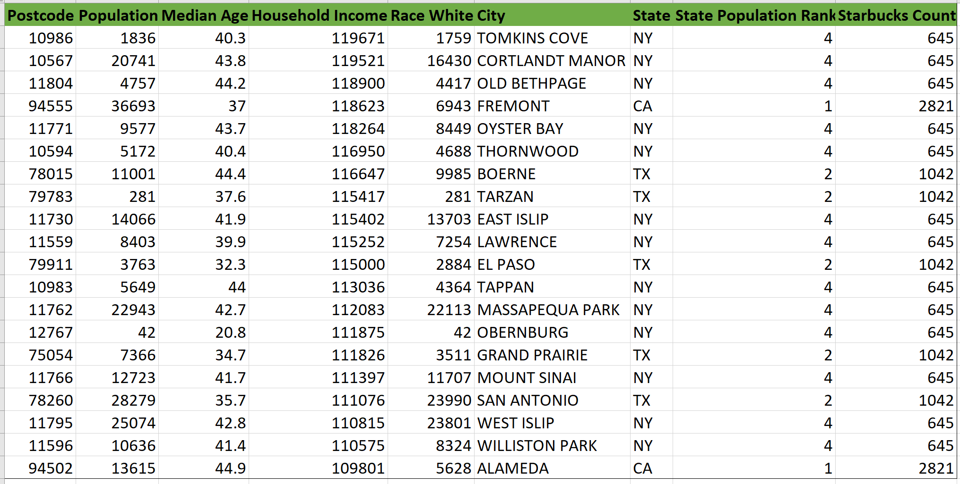
Starbucks Store Count-Analysis
Are there enough Starbucks in nearby neighborhoods?
There are 27,455 of 33120 zip codes that have no Starbucks in USA
We found 838 zip codes that are potential Starbucks location
Top 20 zip codes that meet the criteria:
Criteria:
Household Income:
$60,000 – $120,000
Median Age: 35 – 55
State Rank by Population: Top 5

Slide 23
Tweet sentiment
What is the male vs female sentiment for Starbucks?
What is the sentiment for Starbucks against its competitors?

Slide 24
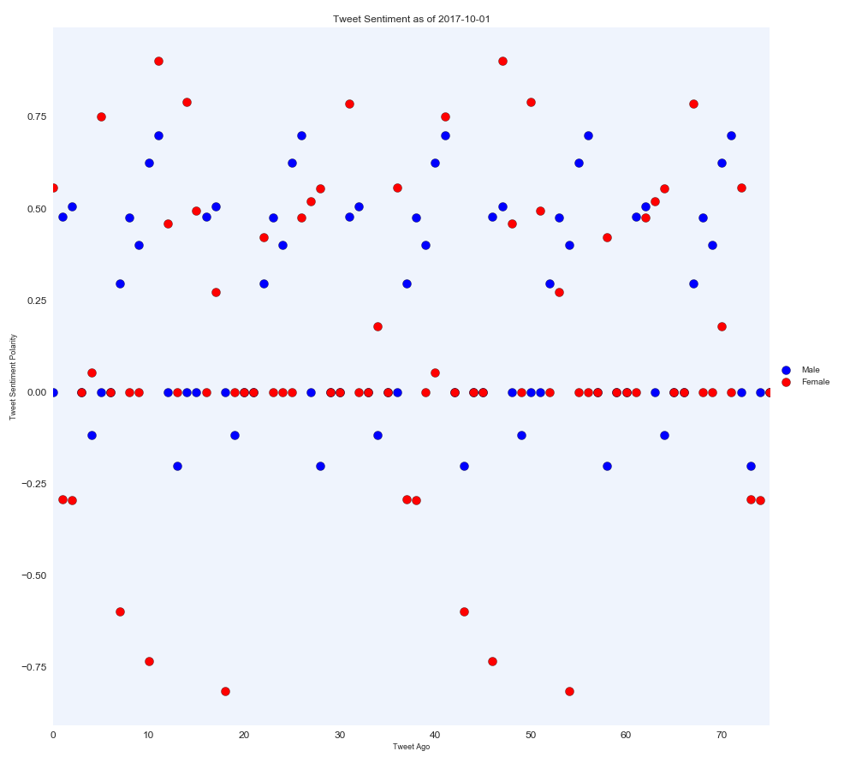
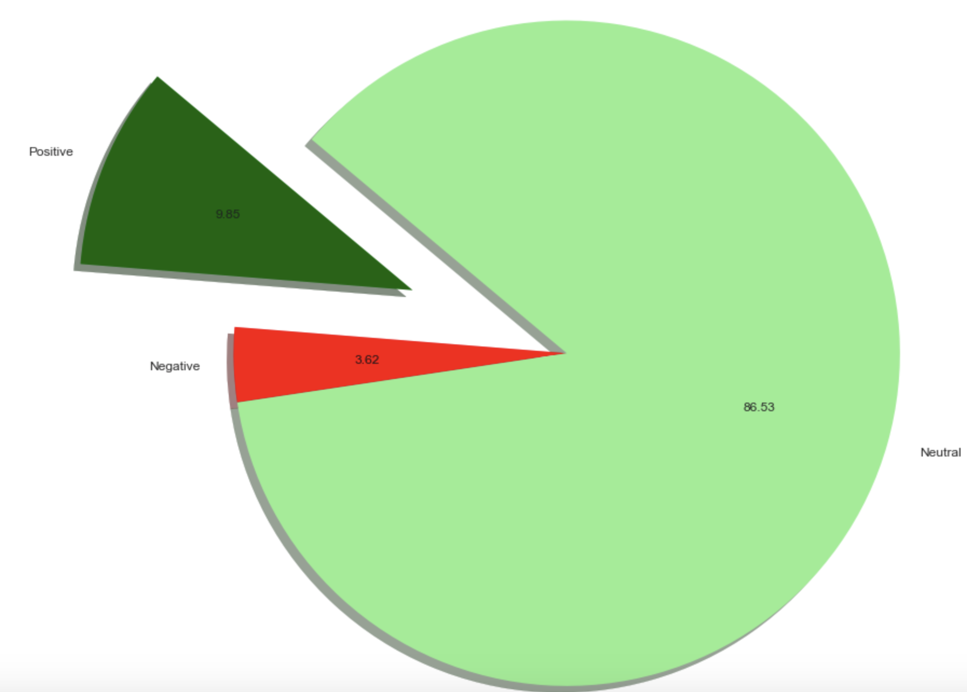
Sentiment Analysis – Male vs Female
What is the Male vs Female sentiments for Starbucks ?
Male tweets more positive for Starbucks
Female tweets more neutral for Starbucks
Overall sentiment for Starbucks is more Neutral.
86 % of tweet are more towards neutral where as ~4% of negative

Slide 25
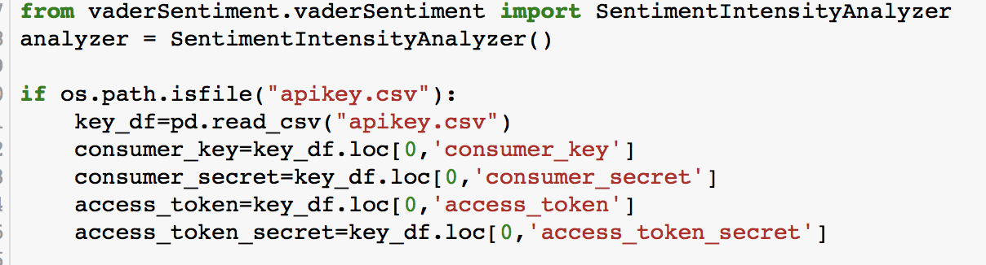
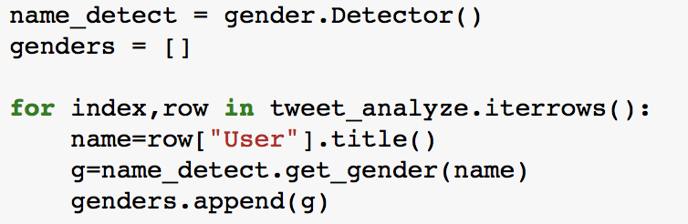
Sentiment – Male vs Female-Approach
Initiating the tweepy API call and using the Vader sentiment analysis
Step 1: Use API to pull all the text related #Starbucks
Step 2: Using Genderguesser package, identify each user name as male and female.
Step 3 :Using scatter plot , plot the value of compound value of each cafe
 | Type of Test | Pvalue
Male Tweet | 1 Sample ttest | 0.01
Female Tweet | 1 Sample ttest | 0.24
**Pvalue needs to be lower than .05.
files.csv

Slide 26
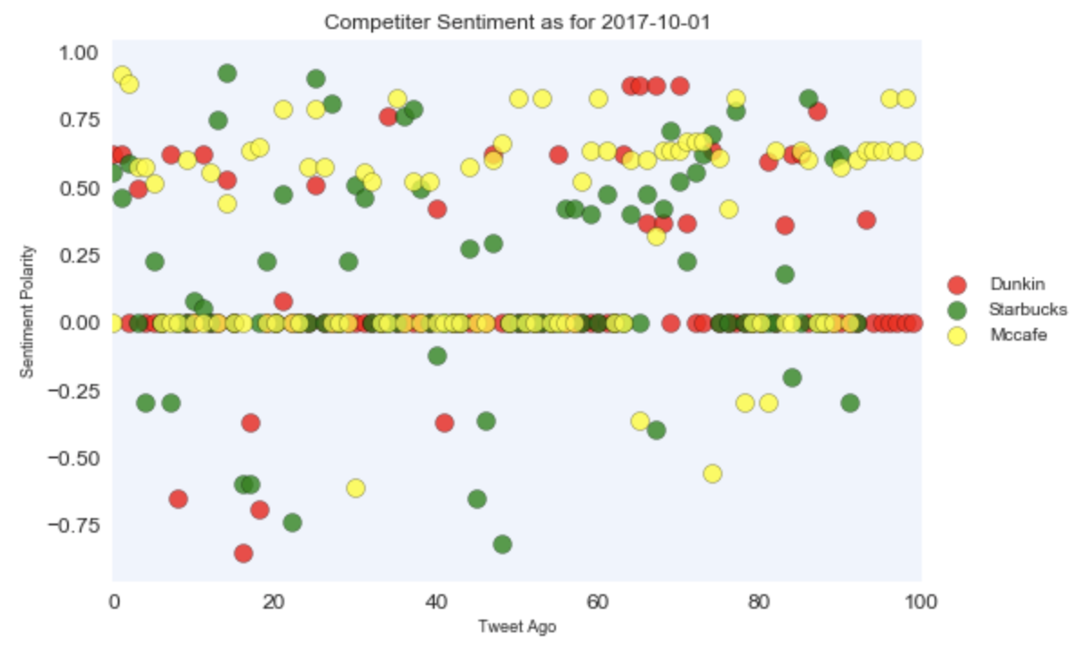
Sentiment Analysis – Starbucks vs Competitors
What is the general feeling of people for Starbucks vs Dunkin Donuts and McCafe?
Sentiments for McCafe is more positive
Sentiments for Starbucks are very neutral

Slide 27
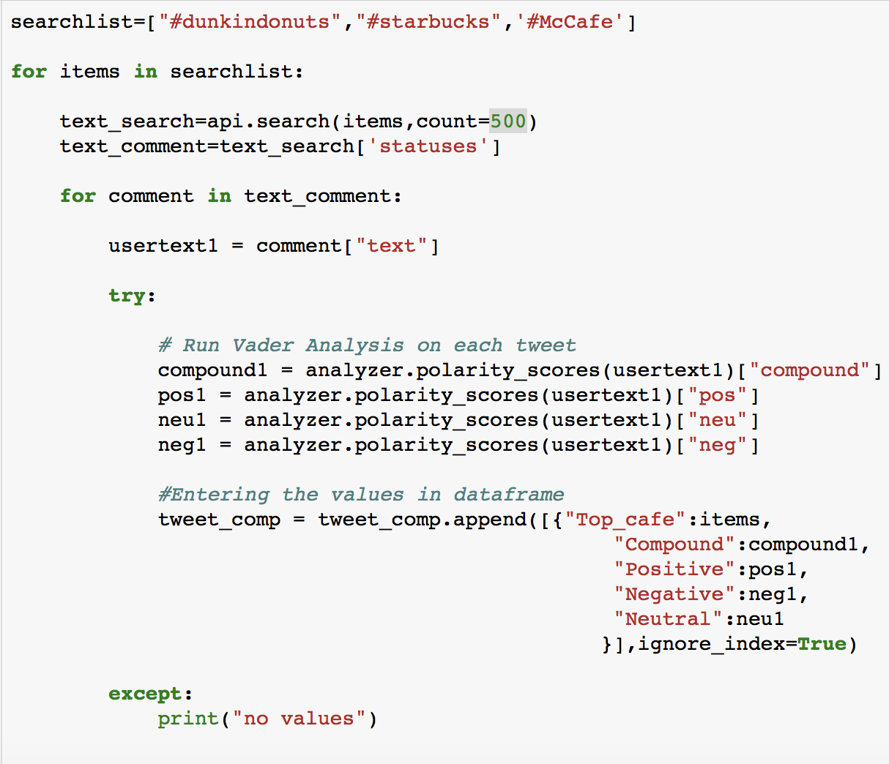
Sentiment – Starbucks vs Competitors- Approach
Initiating the tweepy API call and using the Vader sentiment analysis
Step 1: Created list for each of the café name that I am analyzing
Step 2: Reading 500 # tag for each café and analyze the tweet of the user.
Step 3 :Using scatter plot , plotted the value of compound of each café. Compound is the aggregate value for the positive ,negative and neutral sentiments

Slide 28
Conclusion:
As per our analysis
Global distribution of Starbucks is not uniform
Store ownership is dependent on the geographical location.
Climate does play major role in store location.
Starbucks does have strong competition in US.
As per the Twitter sentiment analysis, tweets are very neutral
There may be many key factors that may result in store density across the world.
We do understand that this project can be extended to include many other factors(e.g. Sales, Products, Property Value)

